Slide 1
Heritage App
SITEM, Paris
Bram Wiercx
12/01/2016 / SITEM, Paris

Slide 2
Donwnload on www.heritageapp.be

Slide 5
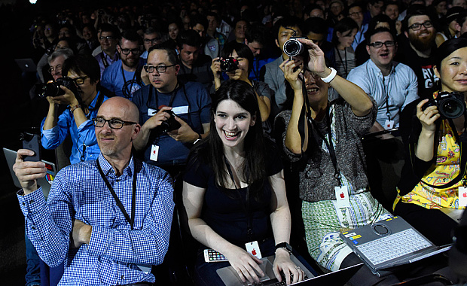

Slide 8
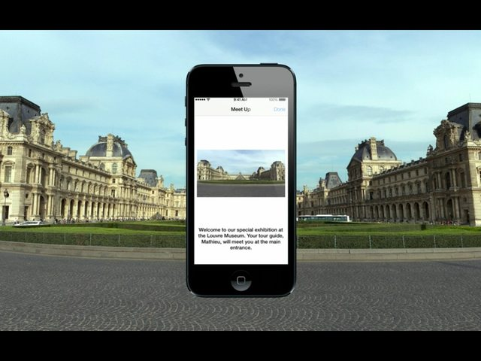

Slide 9
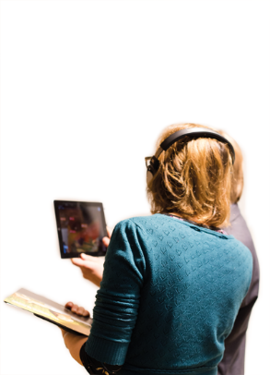
Apps can be your next guide

Slide 10
Notes:
Exploring the museum app to the mona lisa. In the neigberhoud.

Slide 12
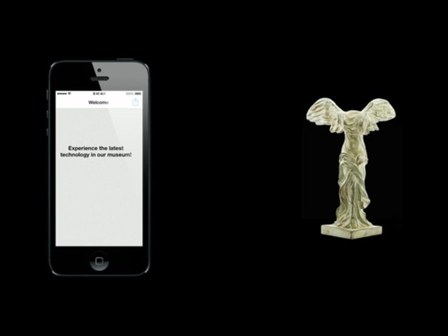

Slide 14
MISSION=INNOVATION

Slide 15
e-cultureproject

Slide 16
HeritageBeacons project

Slide 17
PixLive manager

Slide 18
The Heritage App
heritageapp.be

Slide 19
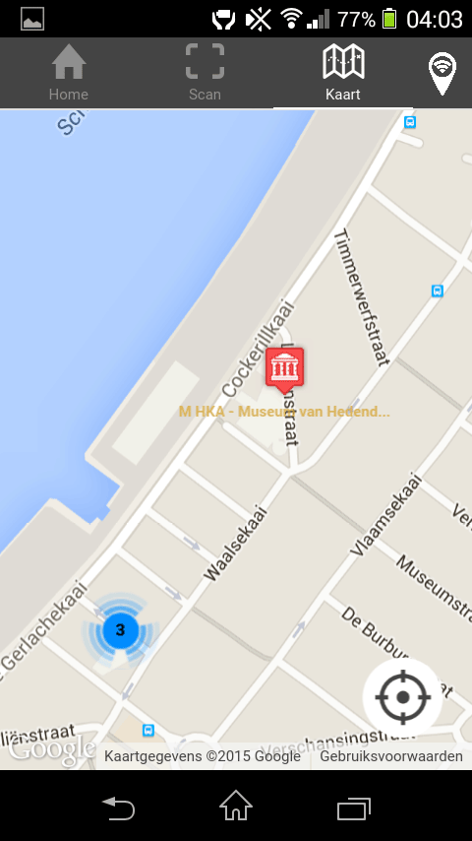
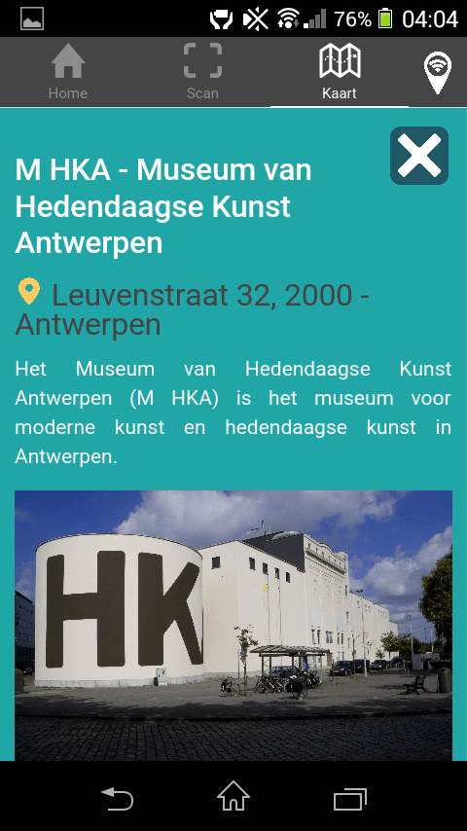

Slide 20
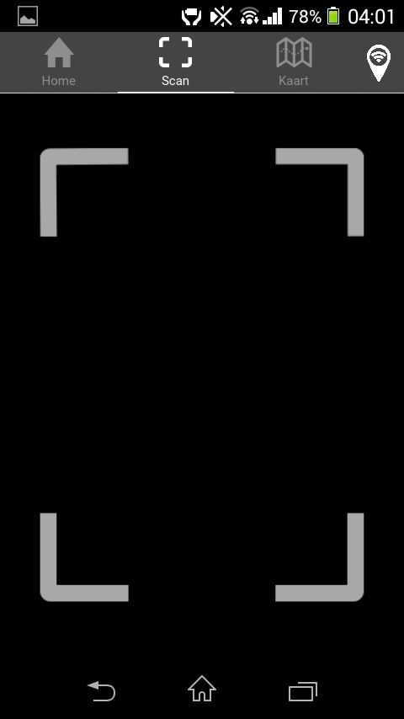
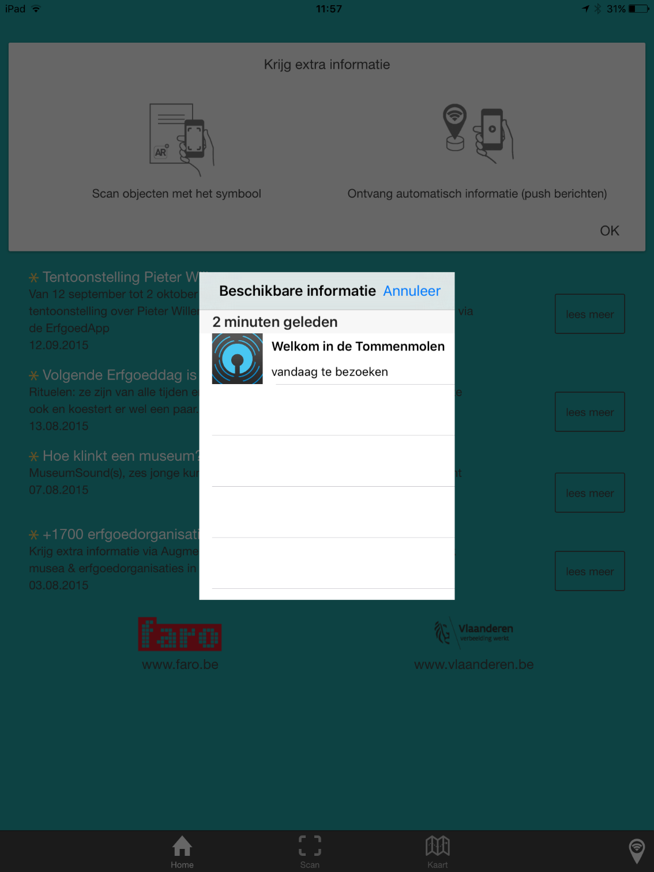

Slide 21
Hands-on Workshops

Slide 22
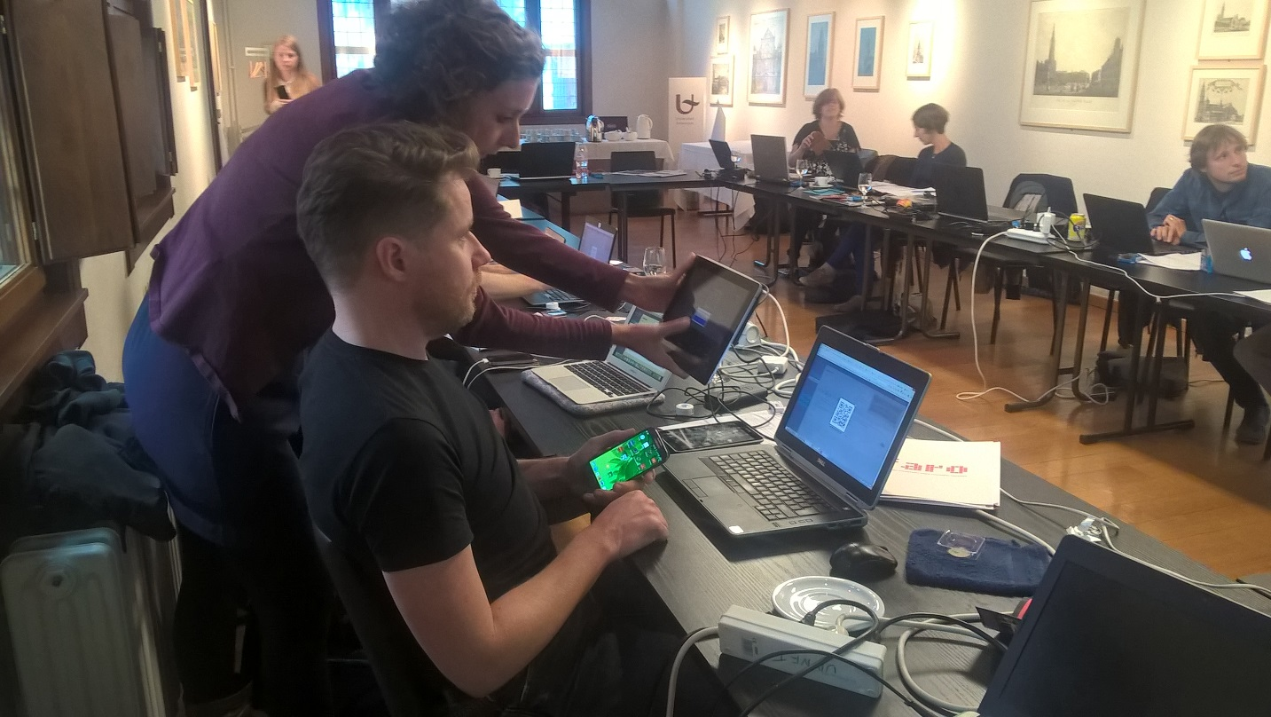
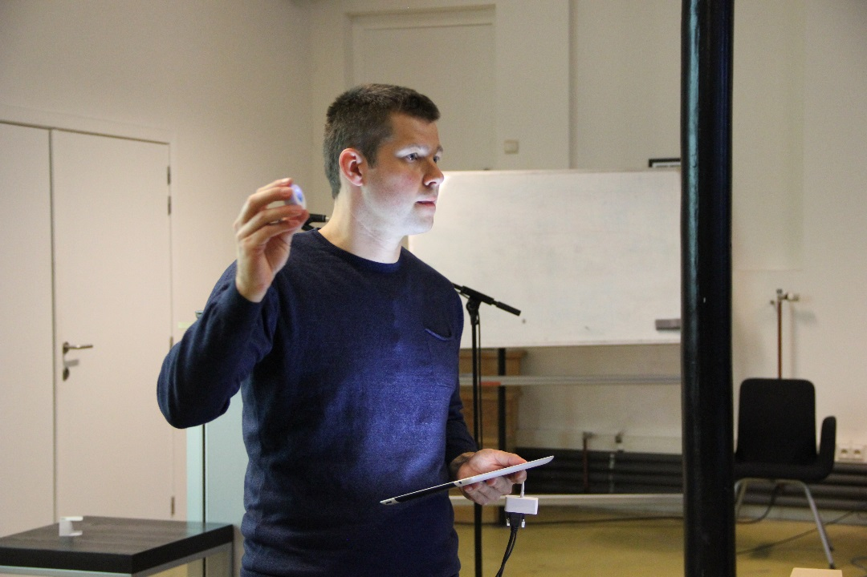
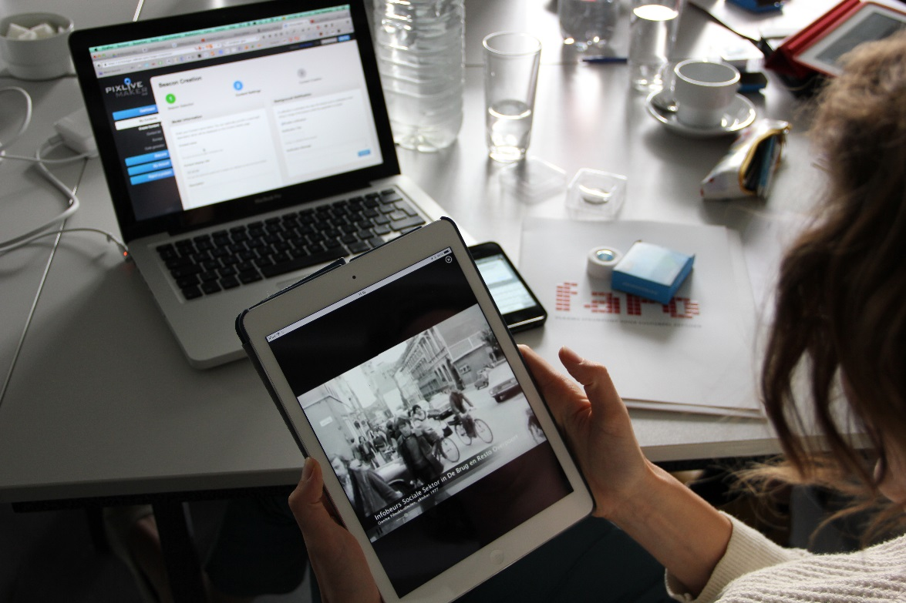
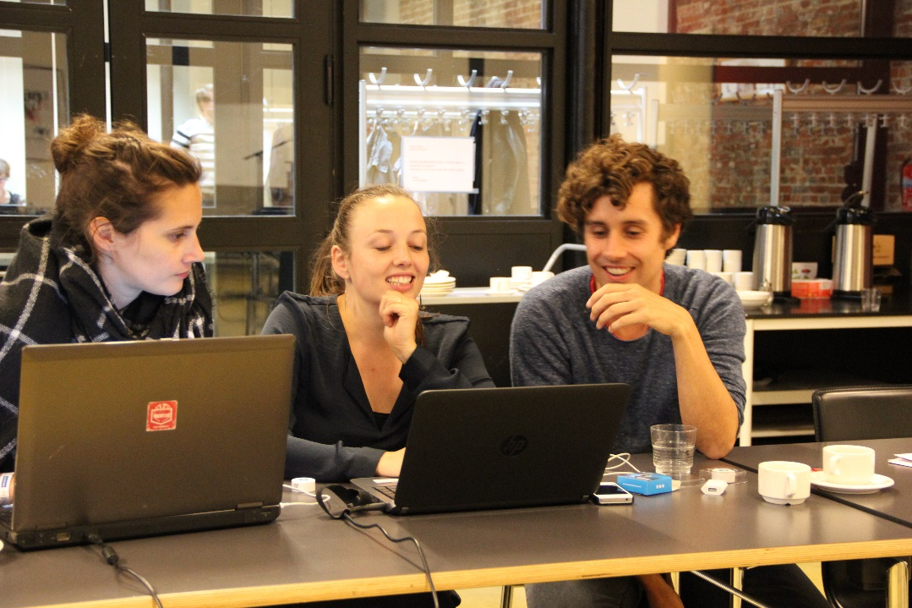

Slide 23
They Learned about iBeacon

Slide 24
And Augmented Reality

Slide 25
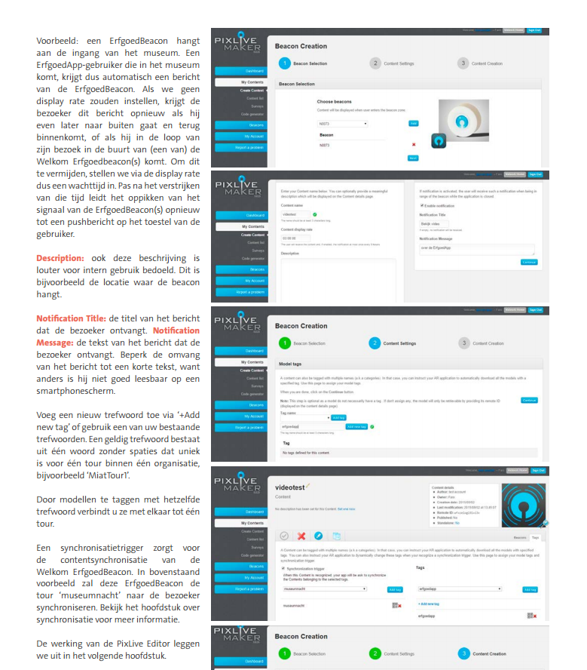
HeritageApp DIY

Slide 26
Launch of the HeritageApp in Flanders & Brussels 19/01/2016

Slide 27
MIAT Gent Museum about industry, labour and textile

Slide 31
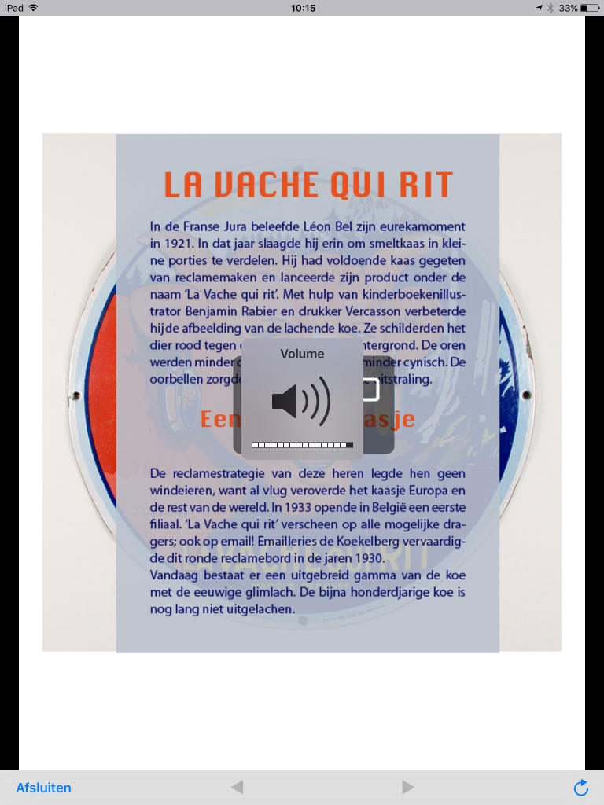
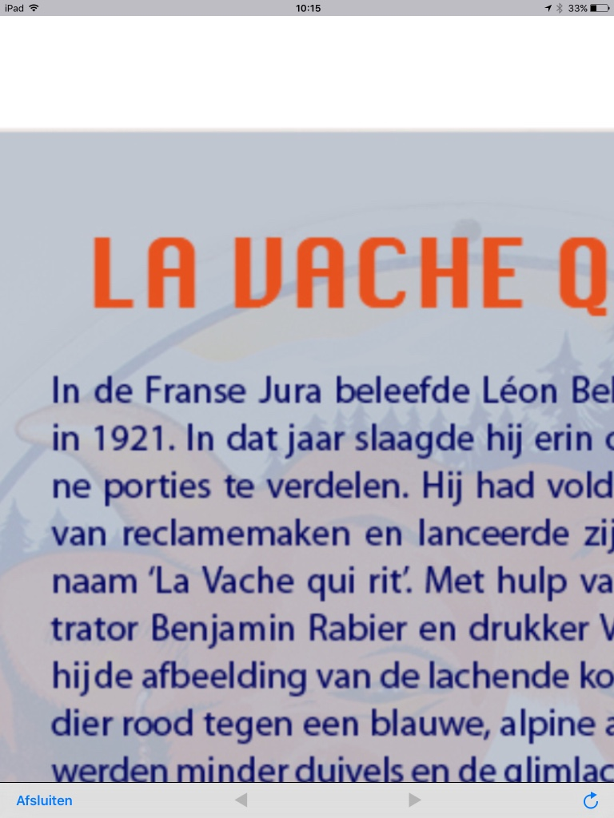

Slide 32
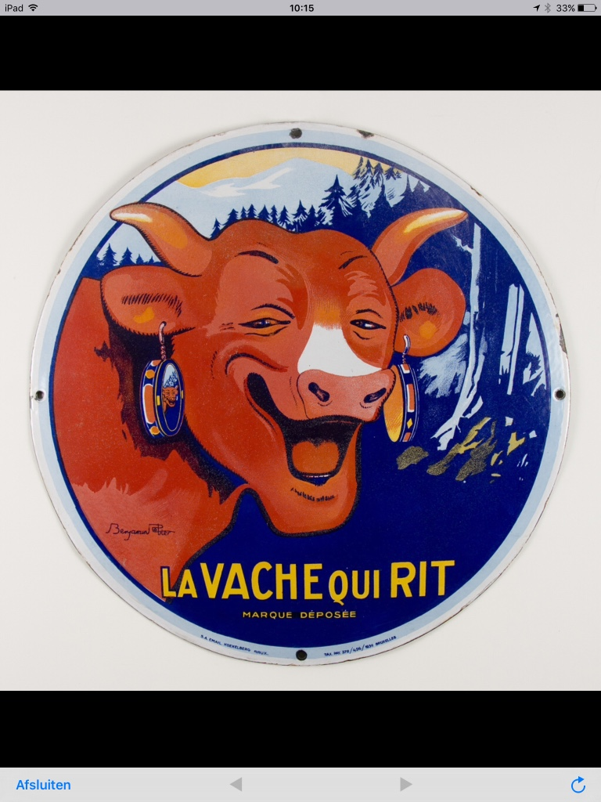

Slide 35
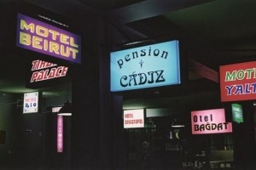
M HKA Antwerp museum of contemporary art antwerp

Slide 36
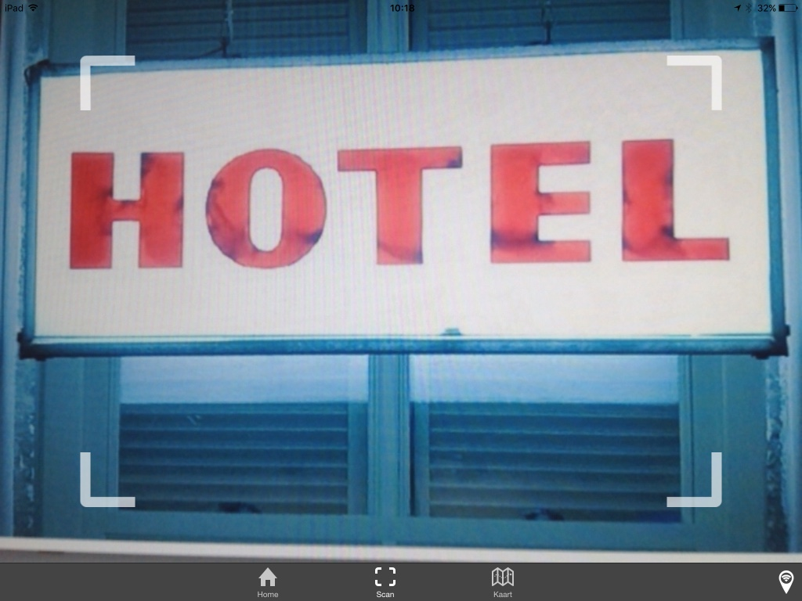

Slide 38
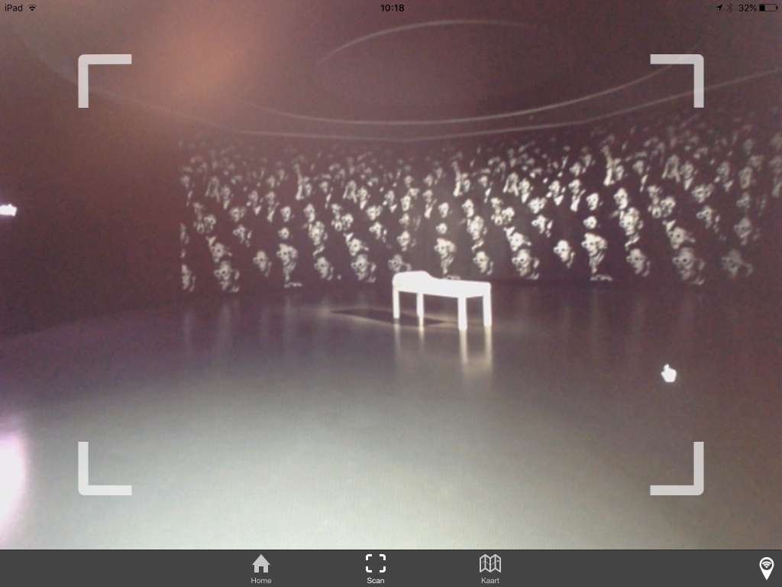

Slide 40
Notes:
Listen to a song

Slide 41
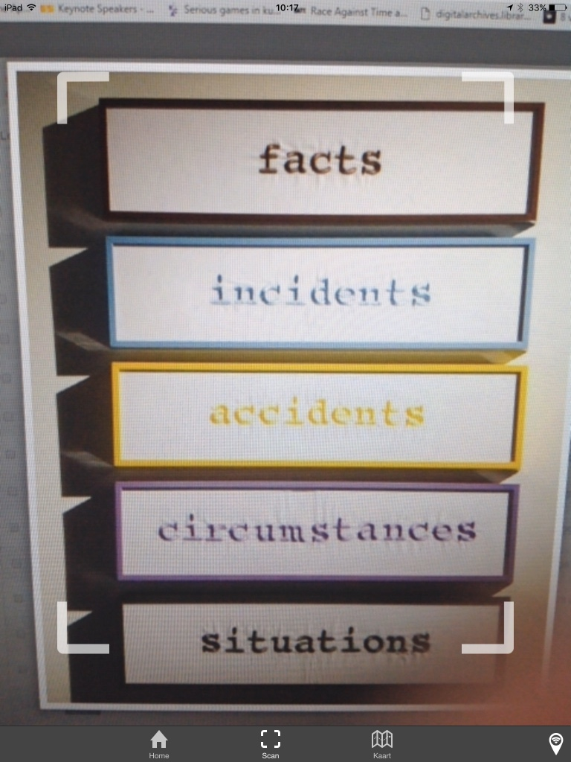

Slide 43
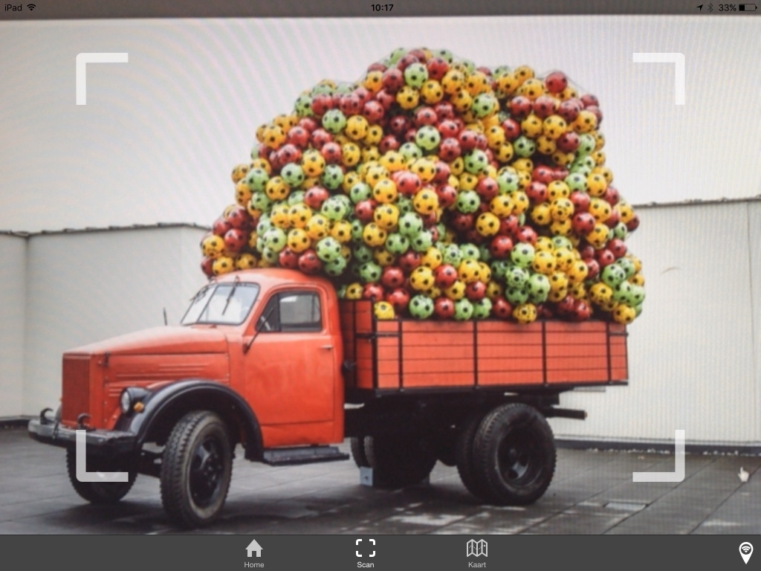

Slide 44
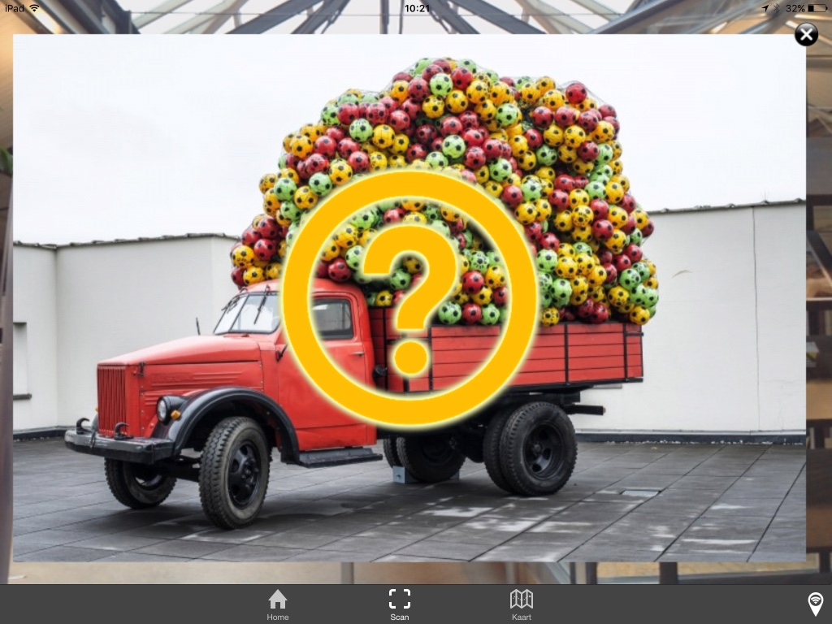

Slide 45
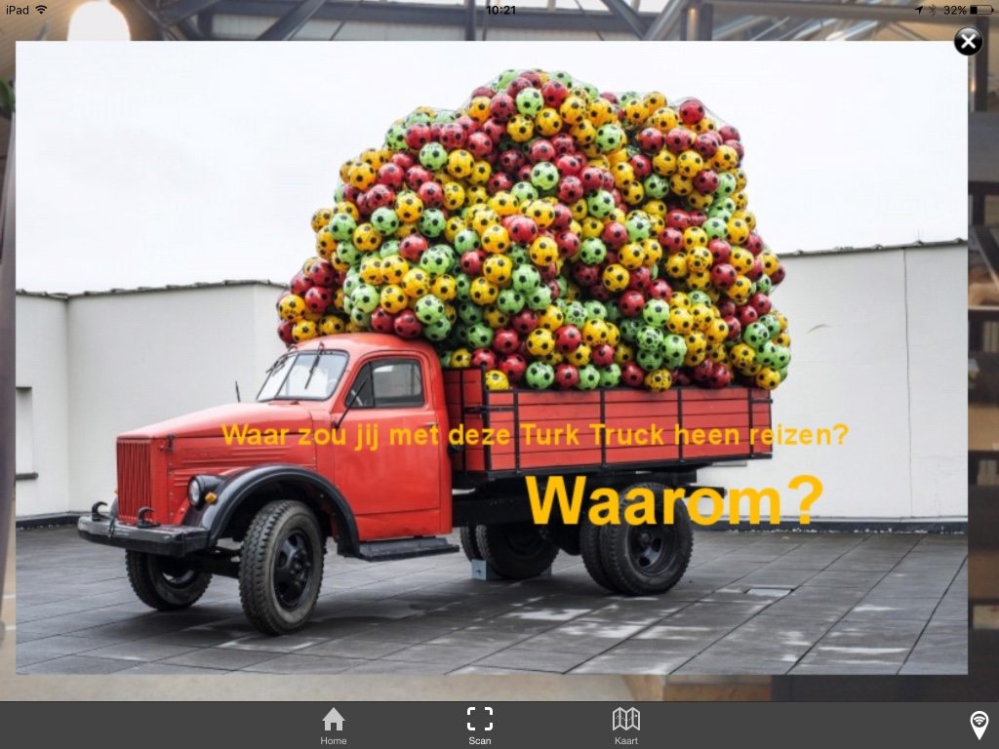

Slide 46
For Who?

Slide 47
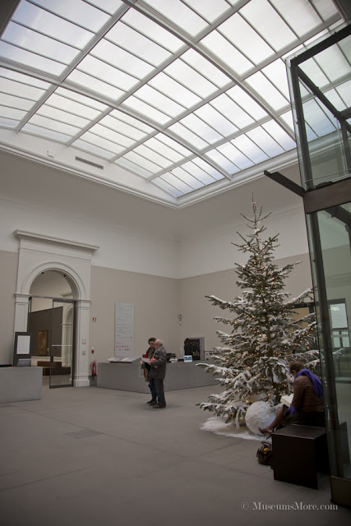
iBeacons at the entrance

Slide 48
Synchronisation

Slide 49
No wifi, 4G,… standalone

Slide 50
AR works also for a magazine

Slide 51
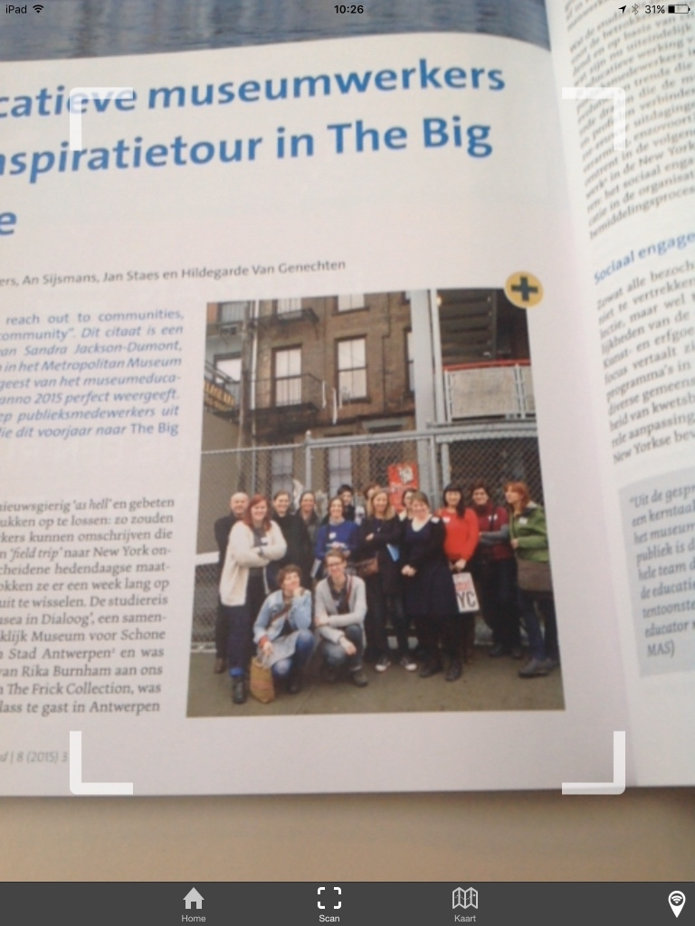
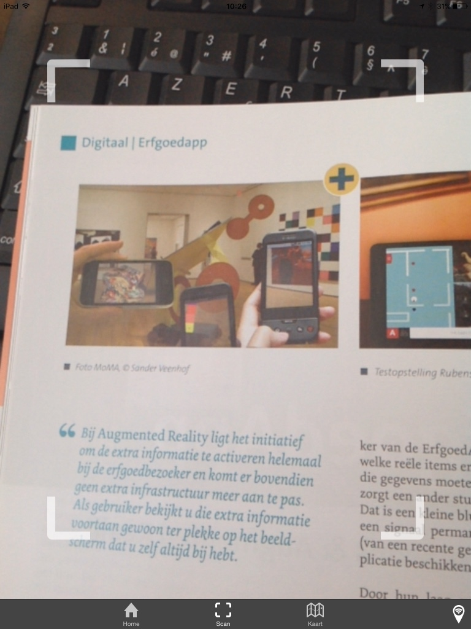

Slide 52
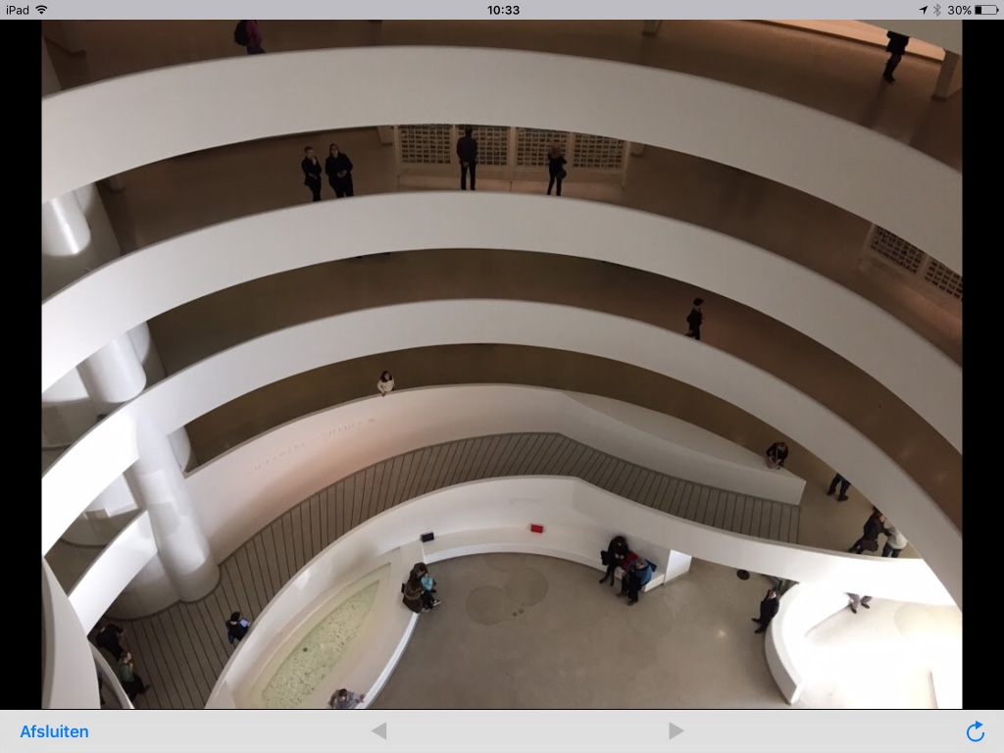
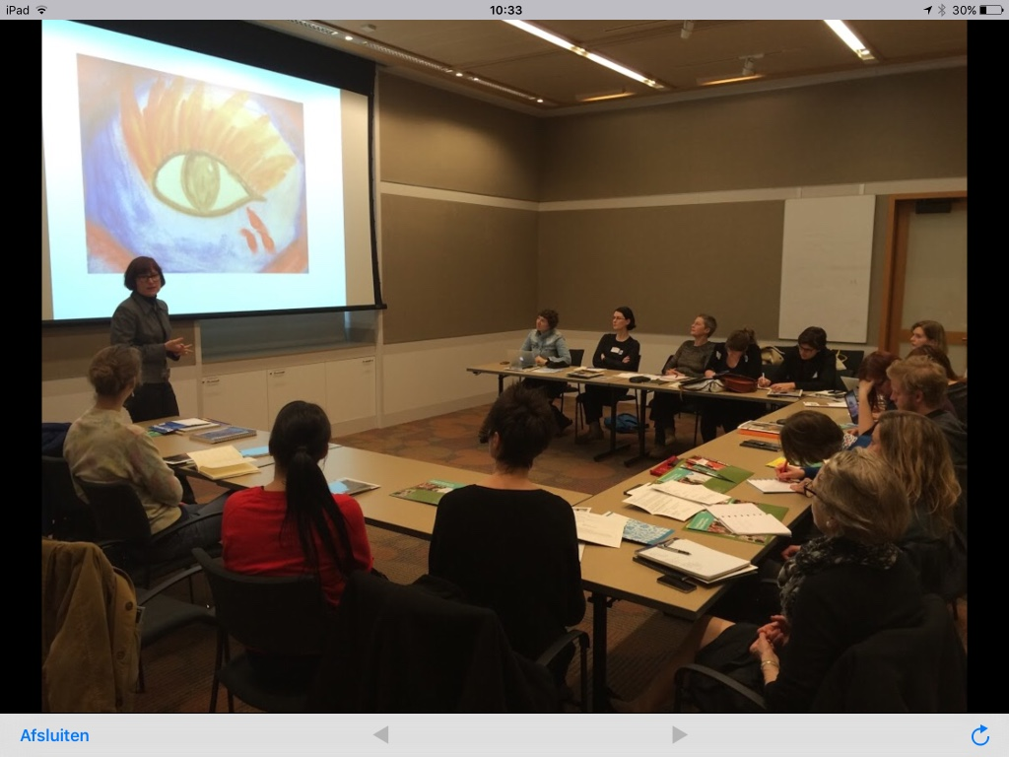
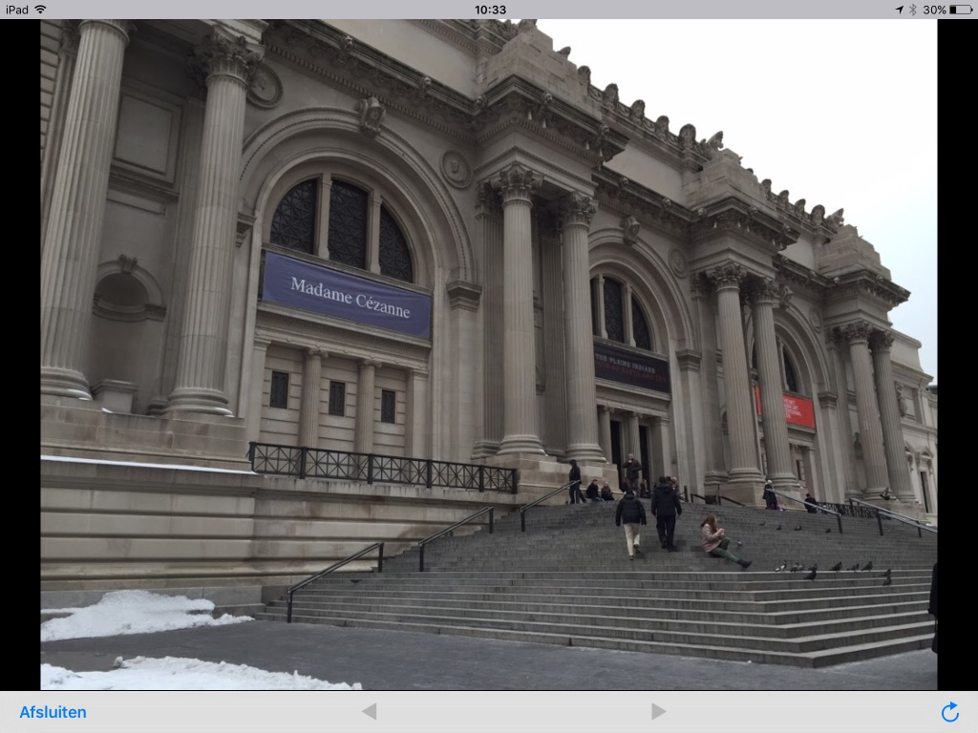

Slide 53
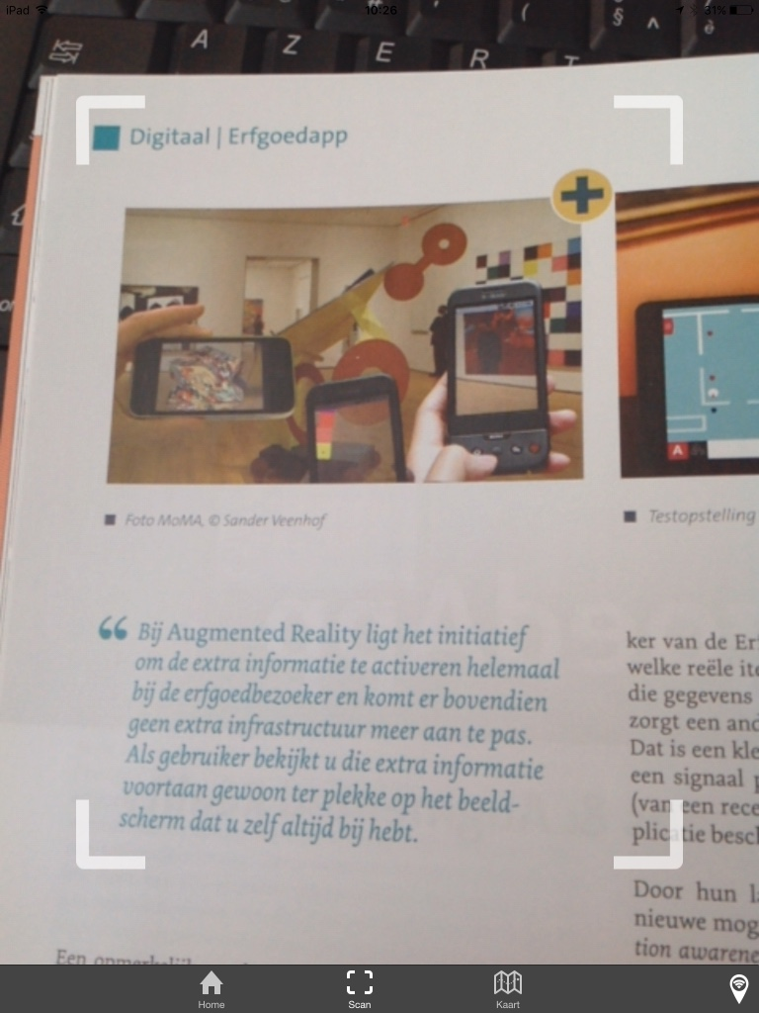

Slide 54
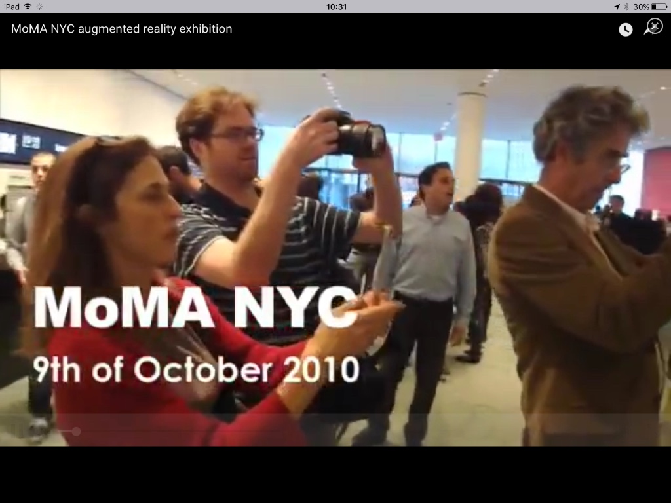

Slide 55
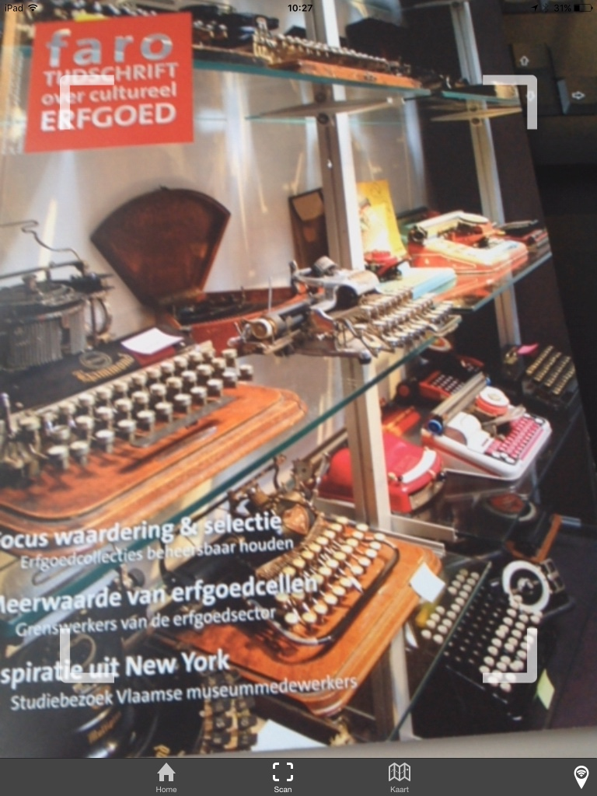

Slide 56
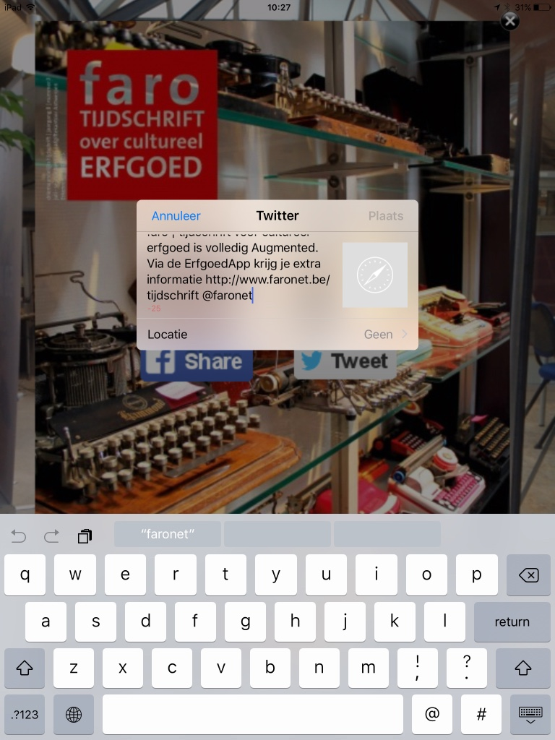

Slide 57
Bram Wiercx
02 213 10 67
bram@faro.be

